Slide 1

Your Name
Notes:
EDITABLE FIELD ON THIS SLIDE: your name.
Click the text that says Your Name and type over it. Everything else on this slide is the CMS approved deck and must not be changed.

Slide 2

Notes:
CMS approved content. Do not edit this slide.

Slide 3

Notes:
CMS approved content. Do not edit this slide.

Slide 4
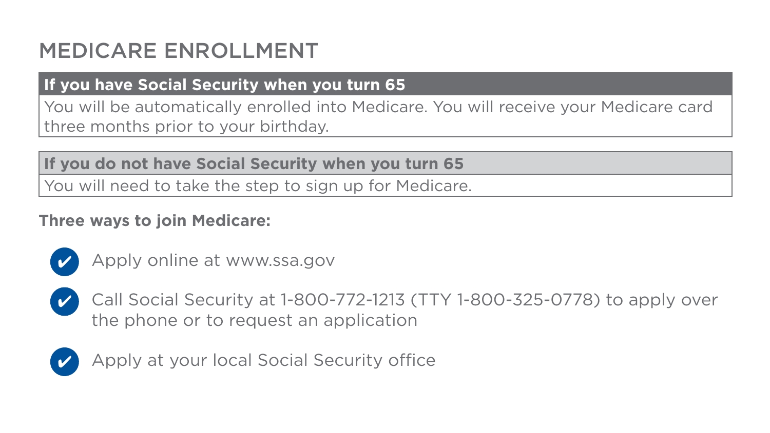
Notes:
CMS approved content. Do not edit this slide.

Slide 5

Notes:
CMS approved content. Do not edit this slide.

Slide 6
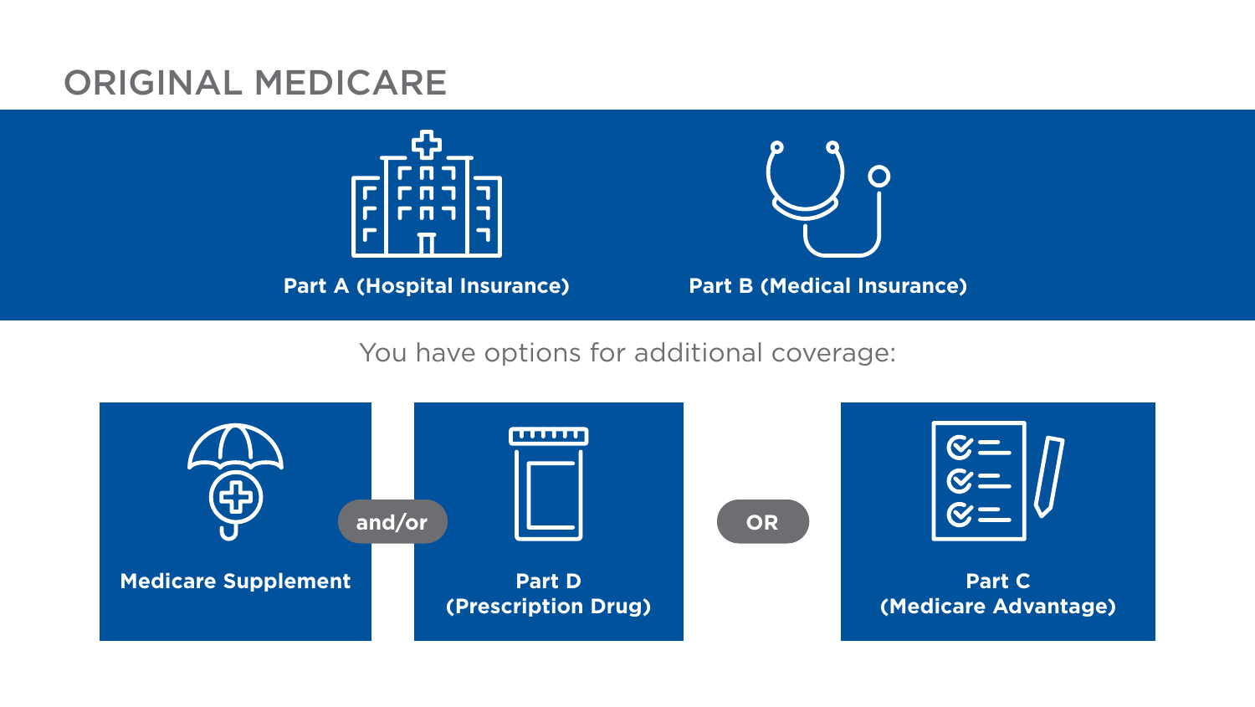
Notes:
CMS approved content. Do not edit this slide.

Slide 7

Notes:
CMS approved content. Do not edit this slide.

Slide 8
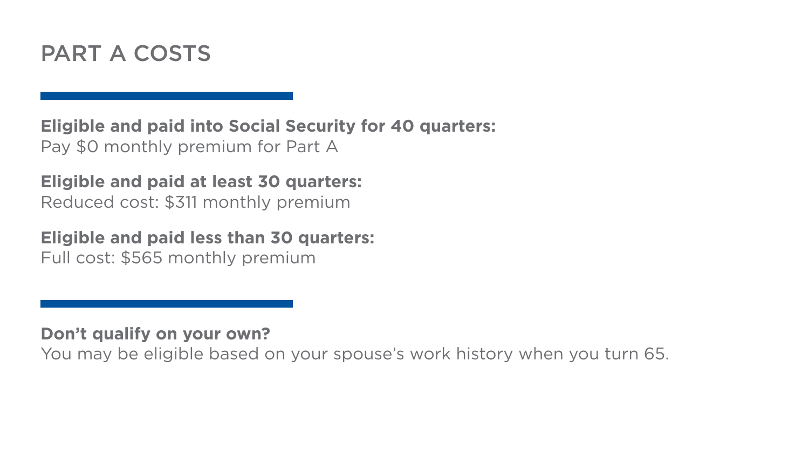
Notes:
CMS approved content. Do not edit this slide.

Slide 9

Notes:
CMS approved content. Do not edit this slide.

Slide 10

Notes:
CMS approved content. Do not edit this slide.

Slide 11
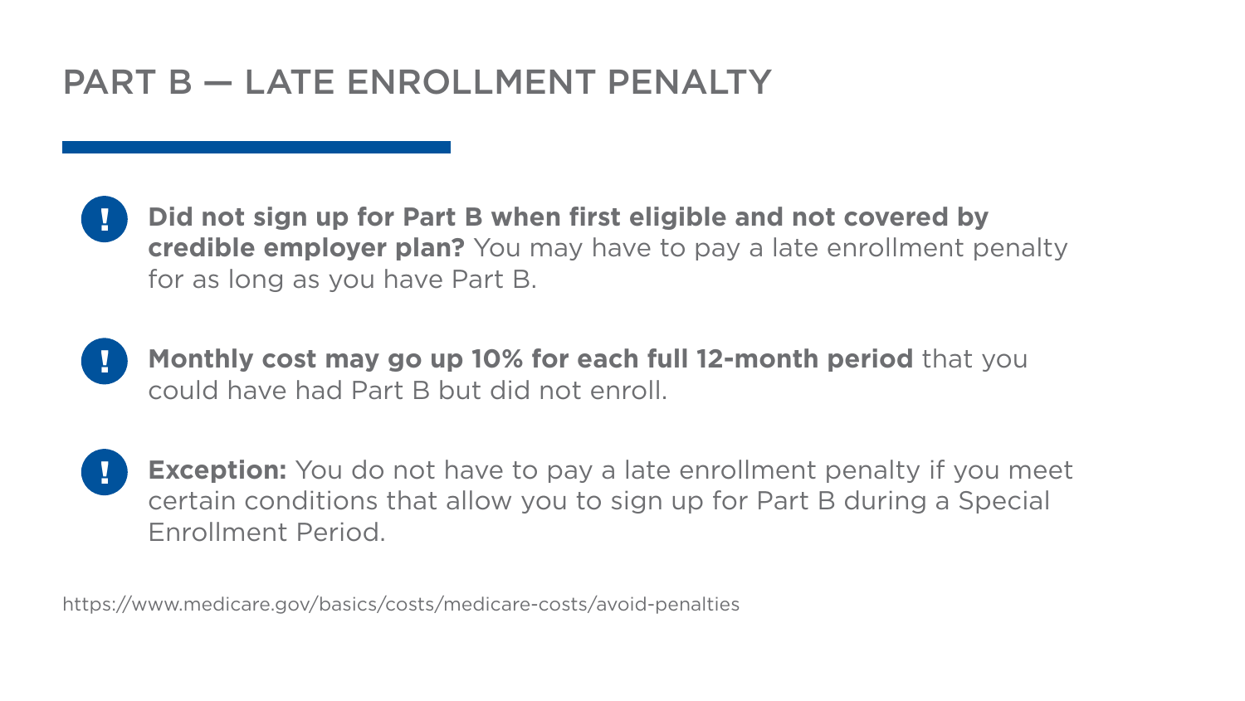
Notes:
CMS approved content. Do not edit this slide.

Slide 12

Notes:
CMS approved content. Do not edit this slide.

Slide 13

Notes:
CMS approved content. Do not edit this slide.

Slide 14
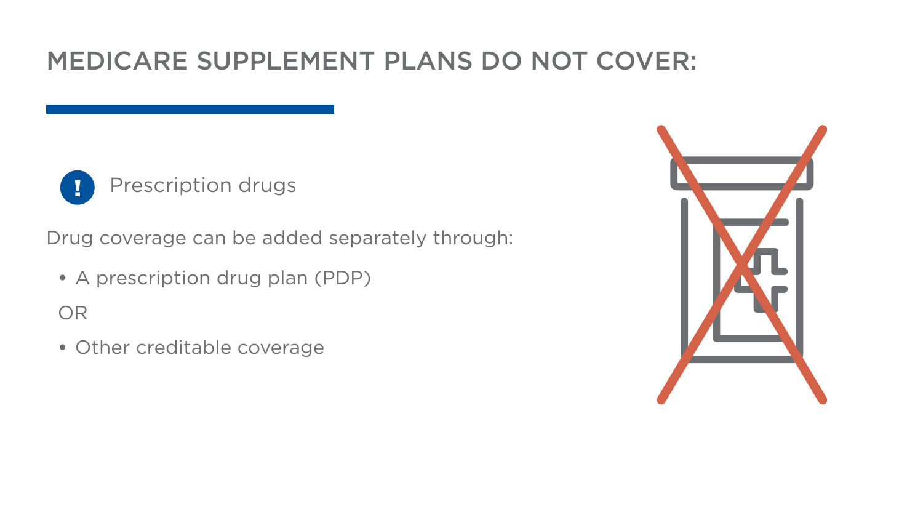
Notes:
CMS approved content. Do not edit this slide.

Slide 15
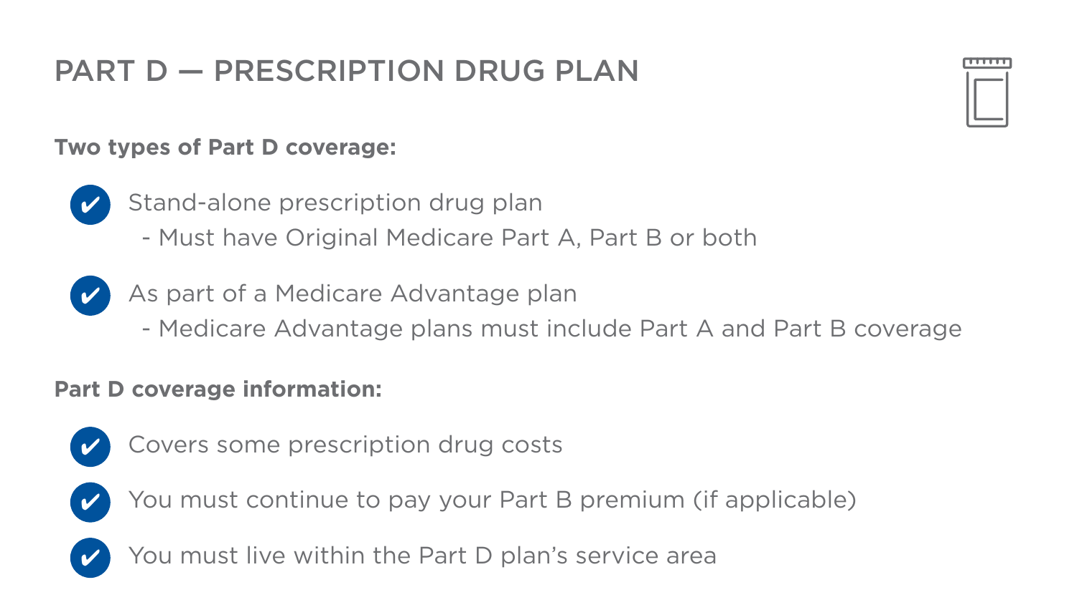
Notes:
CMS approved content. Do not edit this slide.

Slide 16

Notes:
CMS approved content. Do not edit this slide.

Slide 17

Notes:
CMS approved content. Do not edit this slide.

Slide 18

Notes:
CMS approved content. Do not edit this slide.

Slide 19

Notes:
CMS approved content. Do not edit this slide.

Slide 20

Notes:
CMS approved content. Do not edit this slide.

Slide 21
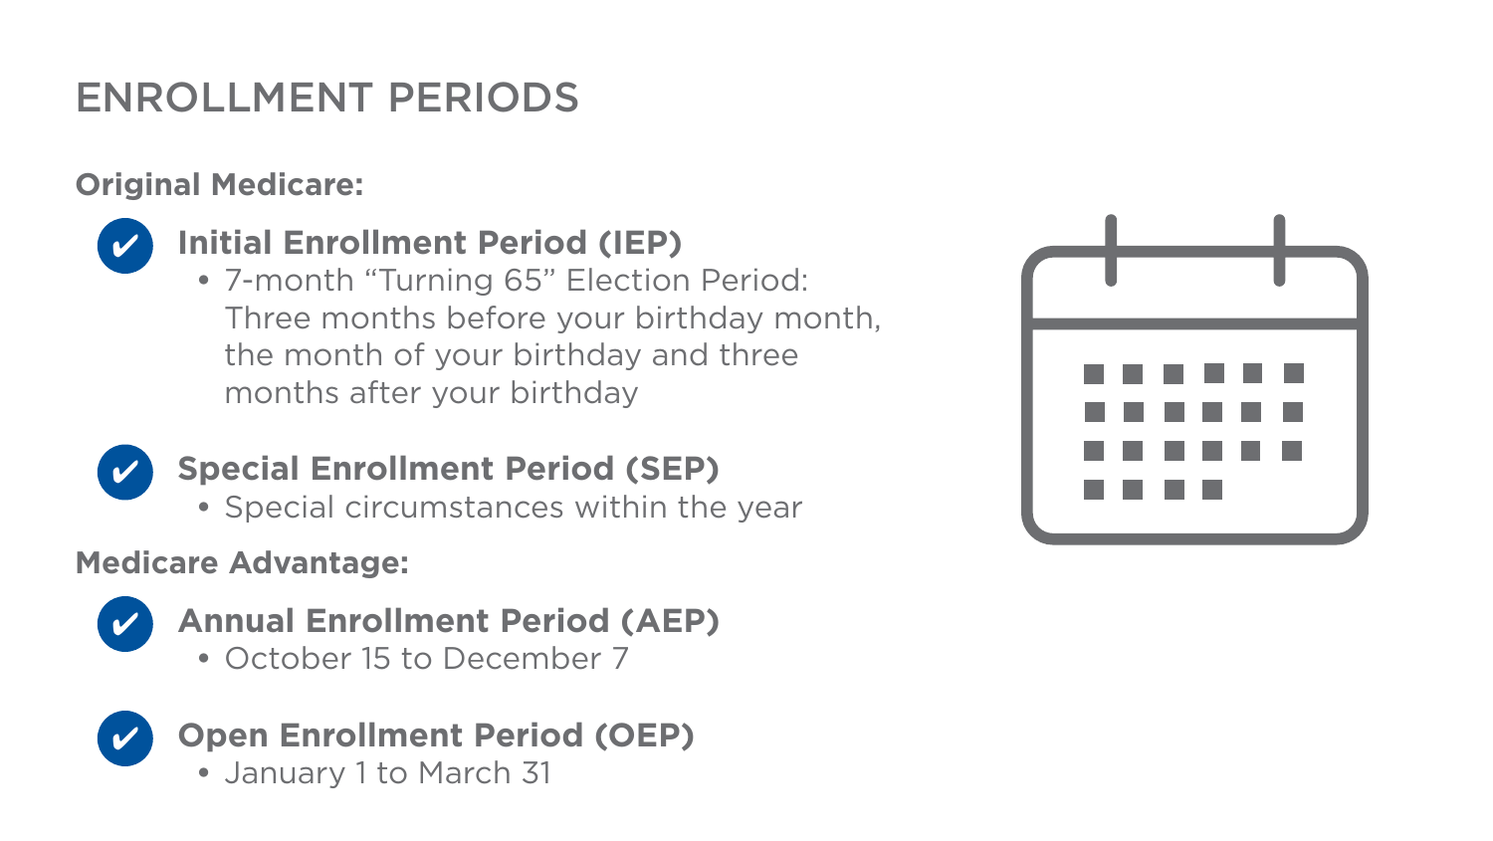
Notes:
CMS approved content. Do not edit this slide.

Slide 22
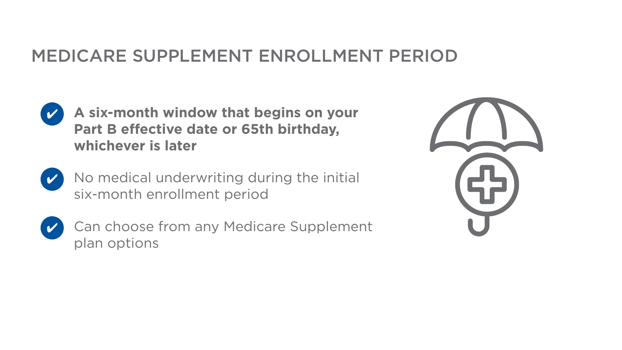
Notes:
CMS approved content. Do not edit this slide.

Slide 23
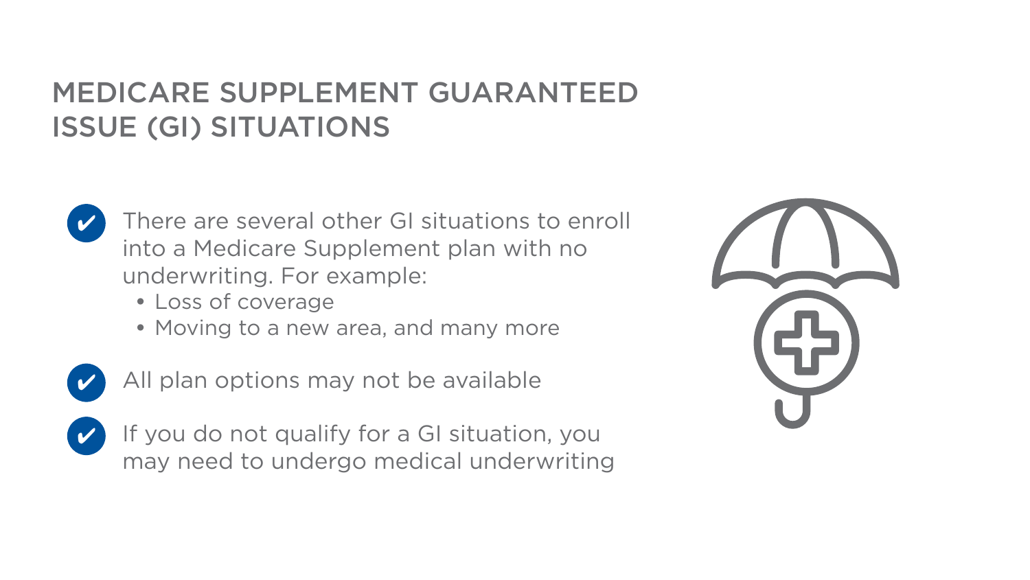
Notes:
CMS approved content. Do not edit this slide.

Slide 24

Notes:
CMS approved content. Do not edit this slide.

Slide 25

Notes:
CMS approved content. Do not edit this slide.

Slide 26

Notes:
CMS approved content. Do not edit this slide.

Slide 27

Notes:
CMS approved content. Do not edit this slide.

Slide 28
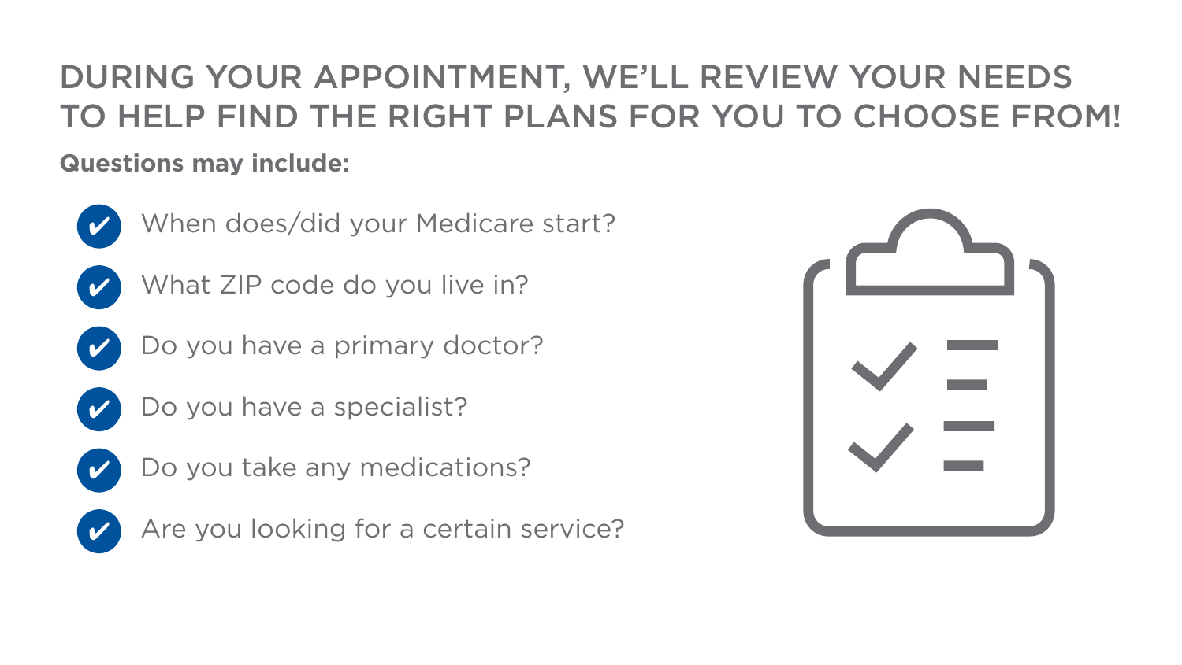
Notes:
CMS approved content. Do not edit this slide.

Slide 29

Your Name
Your Phone Number
NPN: Your NPN
your@email.com
Notes:
EDITABLE FIELDS ON THIS SLIDE: name, phone, NPN, email.
Click each placeholder and type over it. Do not move or resize the boxes, they are positioned to match the approved layout.
Everything else, including the disclaimer, is CMS approved through the IMO and must not be altered.

